Slide 1
Stream house
PROPOSED COMMUNITY REVITALIZATION
PROJECT PLAN

Slide 2
Introductions
Volunteer Board of Directors
Community Manager – Kaycie Lambright
Powerstone Property Management
Legal Counsel – David Cane
Cane & Harkins LLP
Construction Manager – Conor Ross & Matt Nawabi
Ross Construction Management

Slide 3
Leak Related Expenses
*** 2023 estimated cost collected from Jan-Apr financials

Slide 4
Why Are We Here?
ROOFS
01
DECKS
02
STUCCO WATERPROOF COATING
03
Notes:
Roofs – Are you in favor of a community-wide reconstruction project?
Decks
Asphalt
Concrete Walkways
Stream Cleaning and Maintenance
Financial Deficit

Slide 5
01 ROOFS
Flat roofs are beyond their useful life

Slide 6
Current Roof Condition
Poor – very poor
Well past useable life
Multiple roof systems
Built-up Roofing Systems (hot mop roofs)
Torch down roofs
Coatings on both (stop-gap measure)

Slide 7
McCarthy Roofing roll-on coating
No flat roofs in the community have been replaced within the last 20+ years
A temporary roll-on coating was applied by McCarthy Roofing as a stop-gap measure
190 Singingwood #11,
190 Singingwood #12
204 Singingwood #2
5727 Stillwater #11
5846 Creekside #9
190 Singingwood #14
178 Singingwood #2

Slide 8
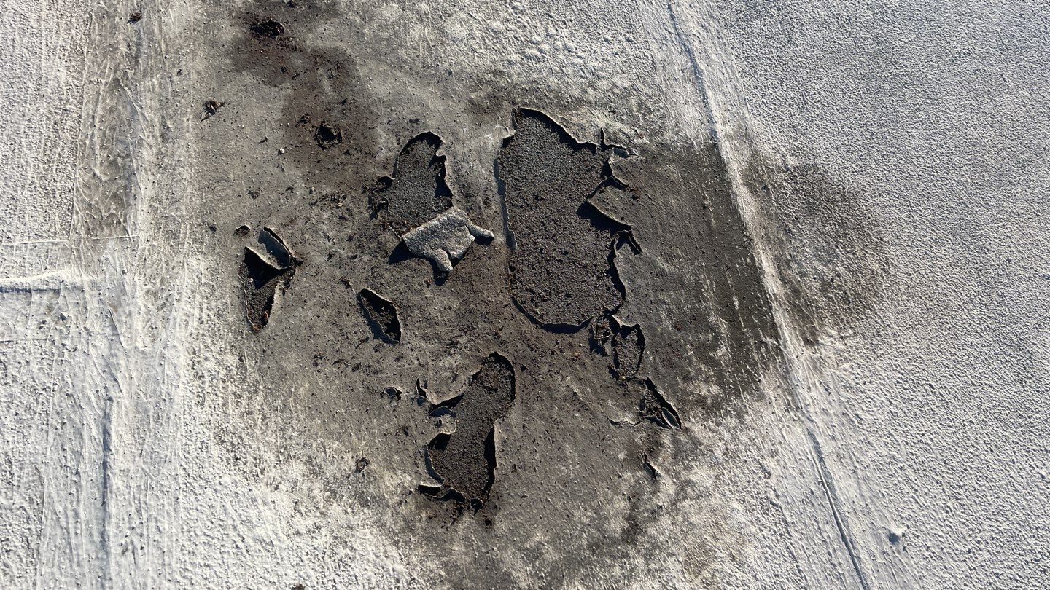
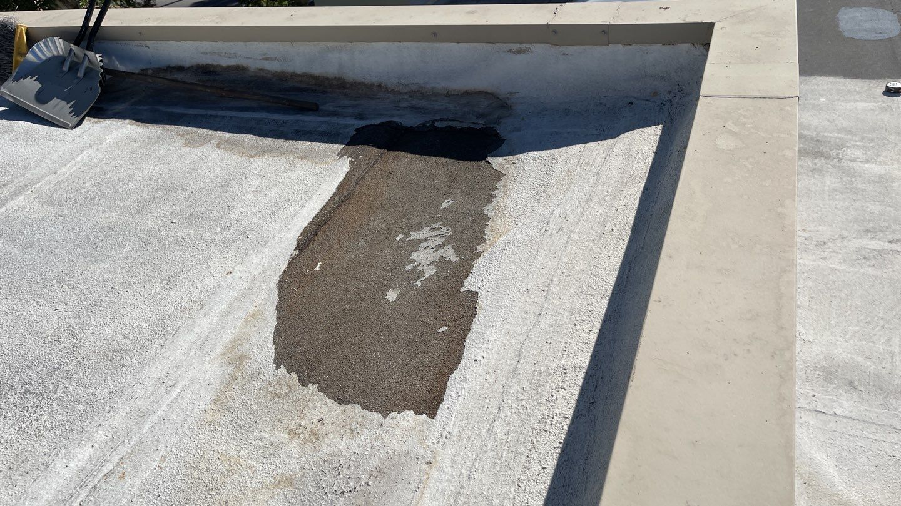
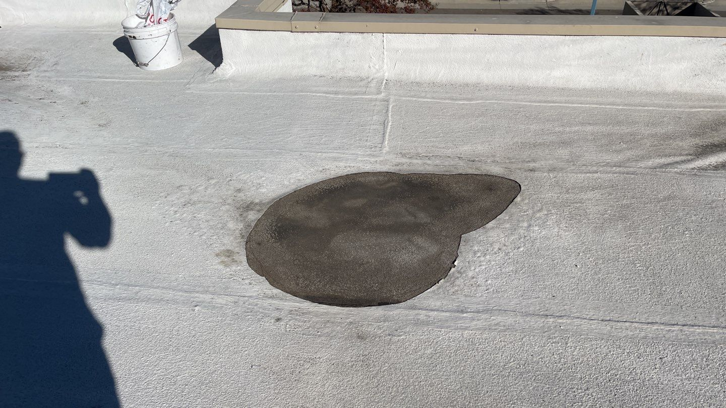
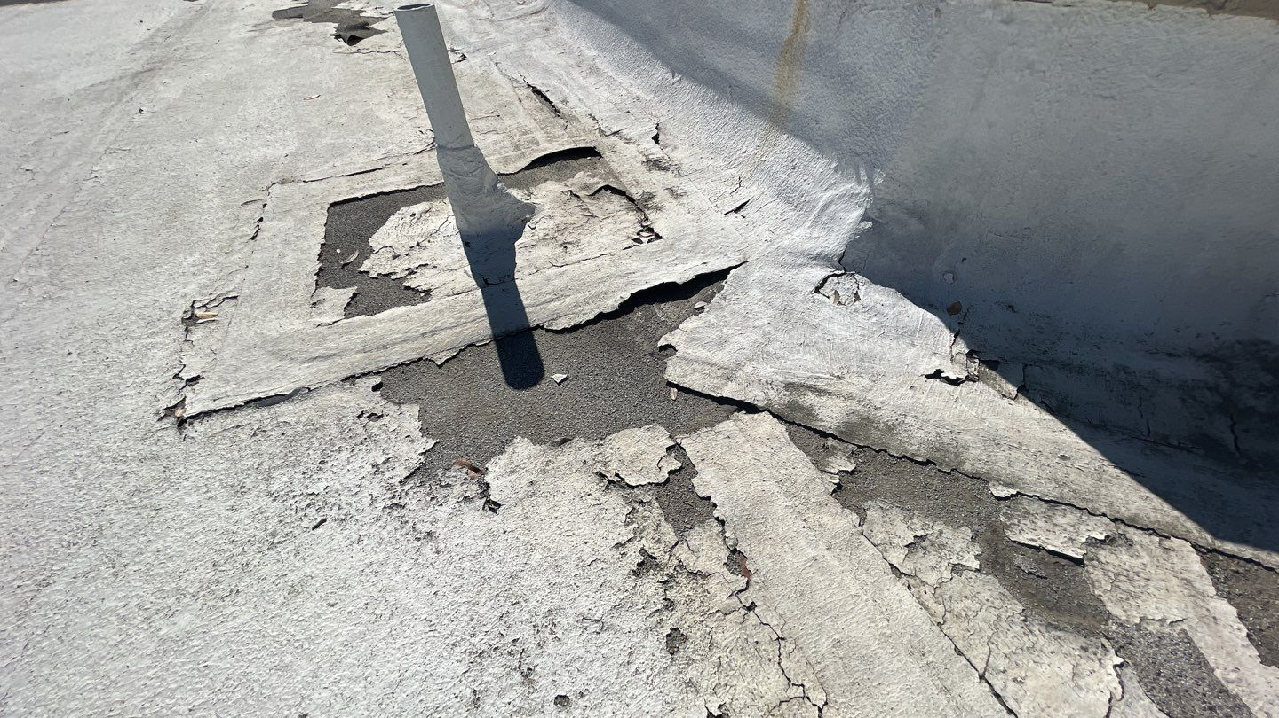
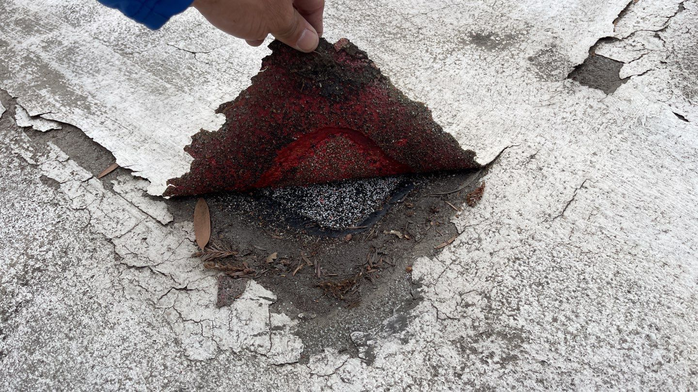
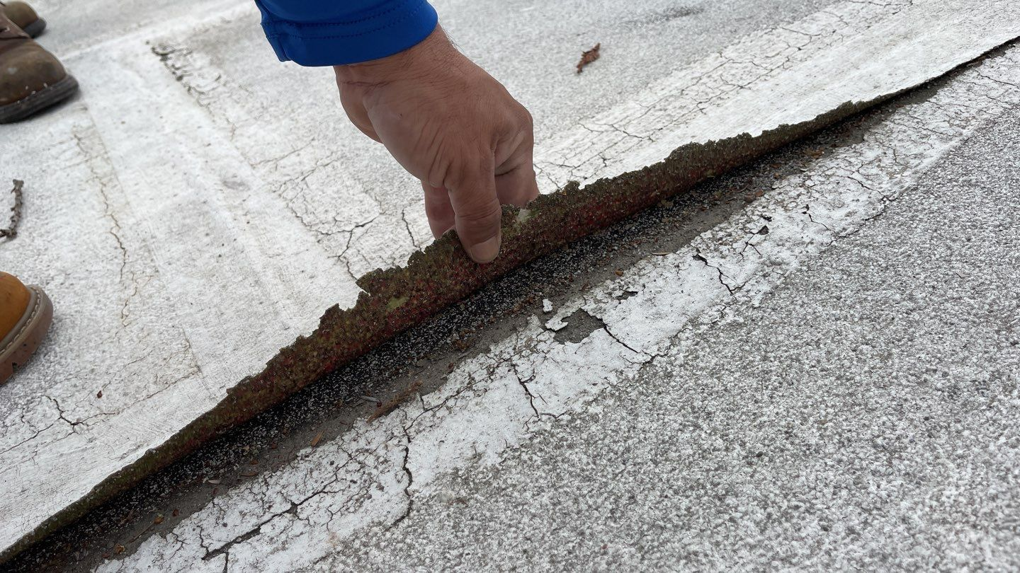
Condition of roll-on coating

Slide 9
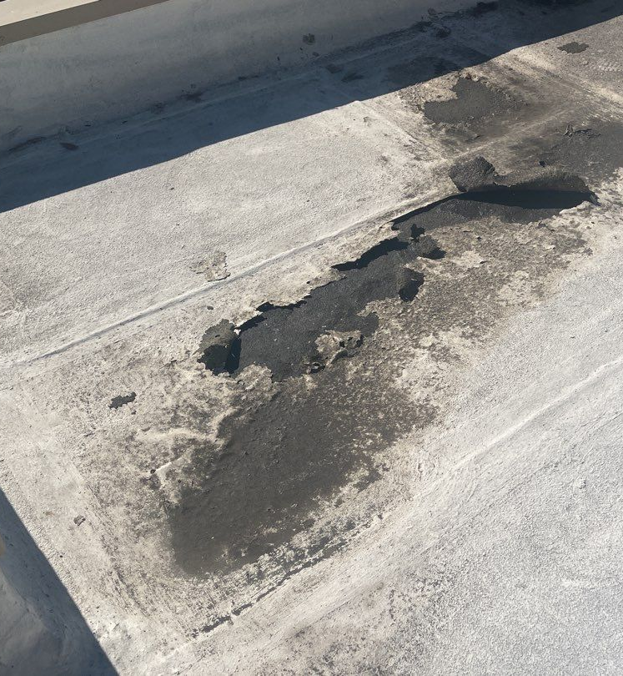
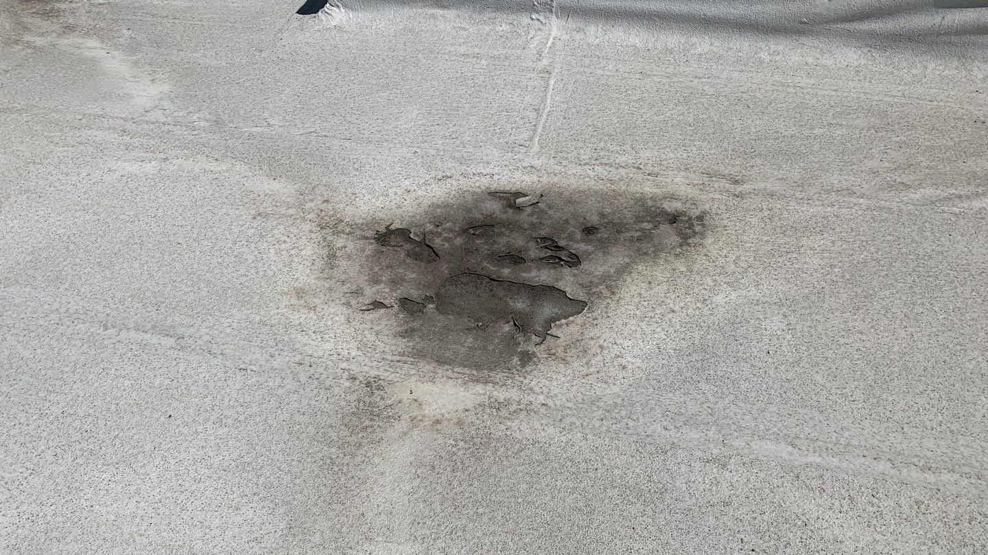
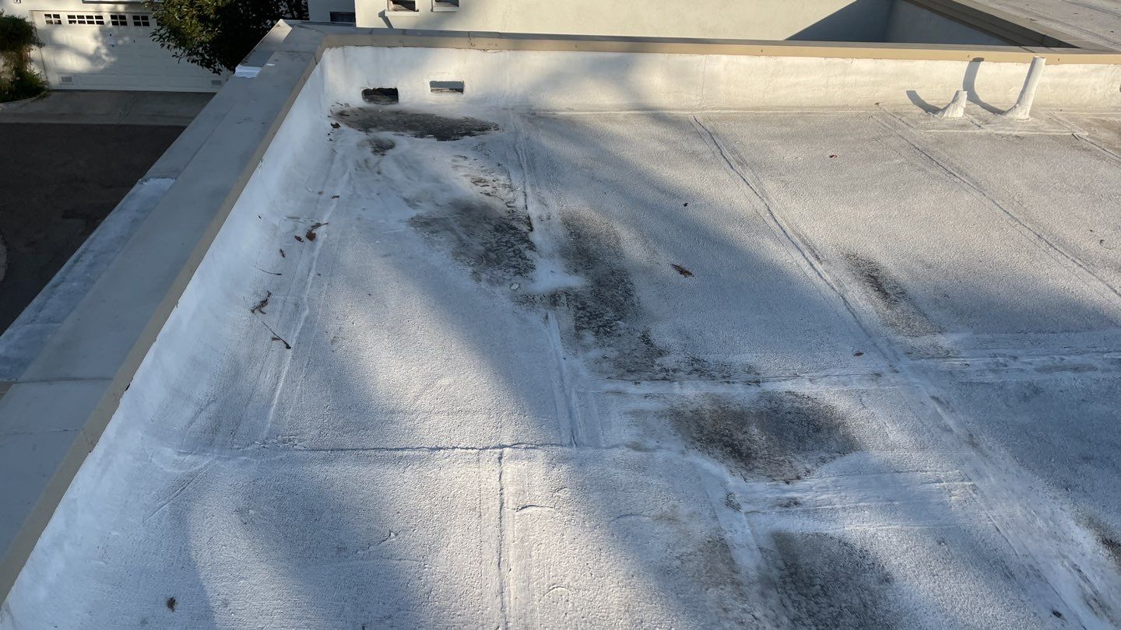
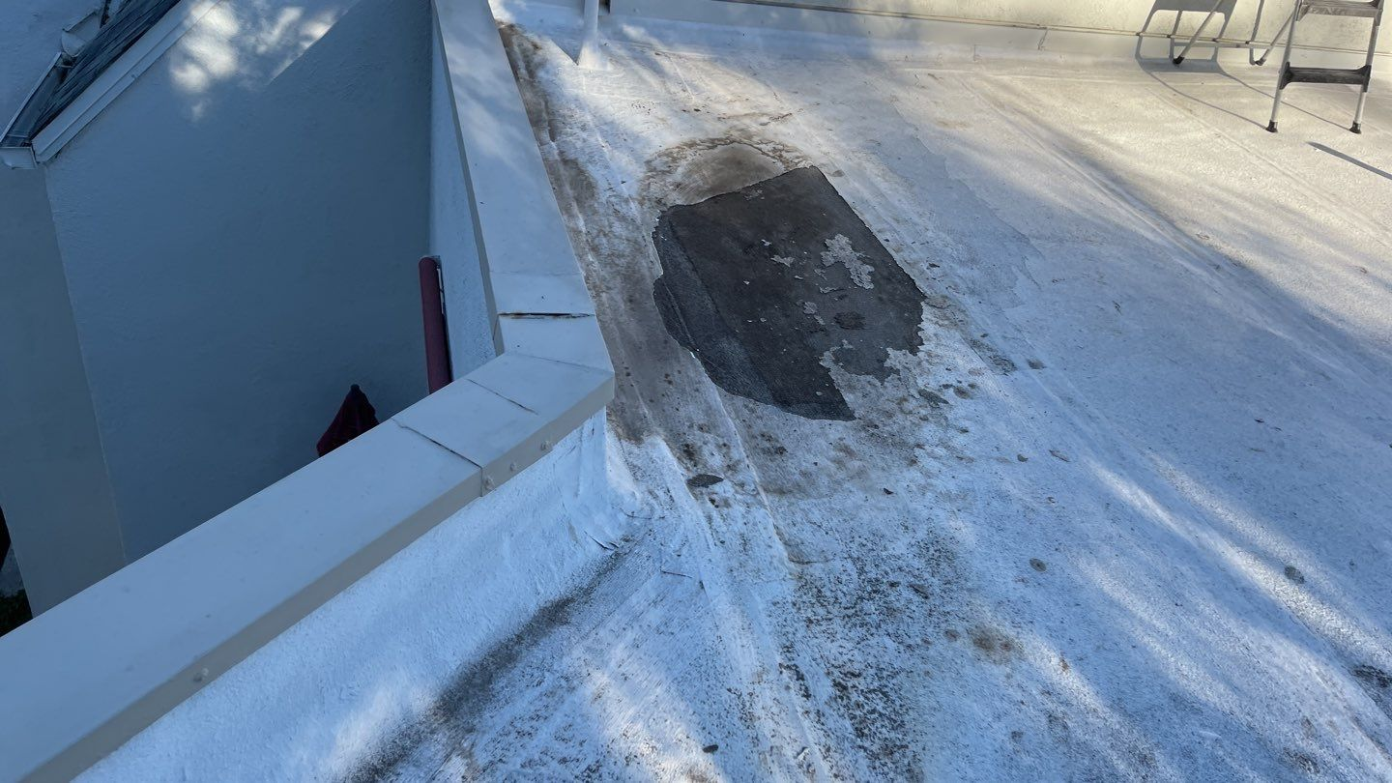
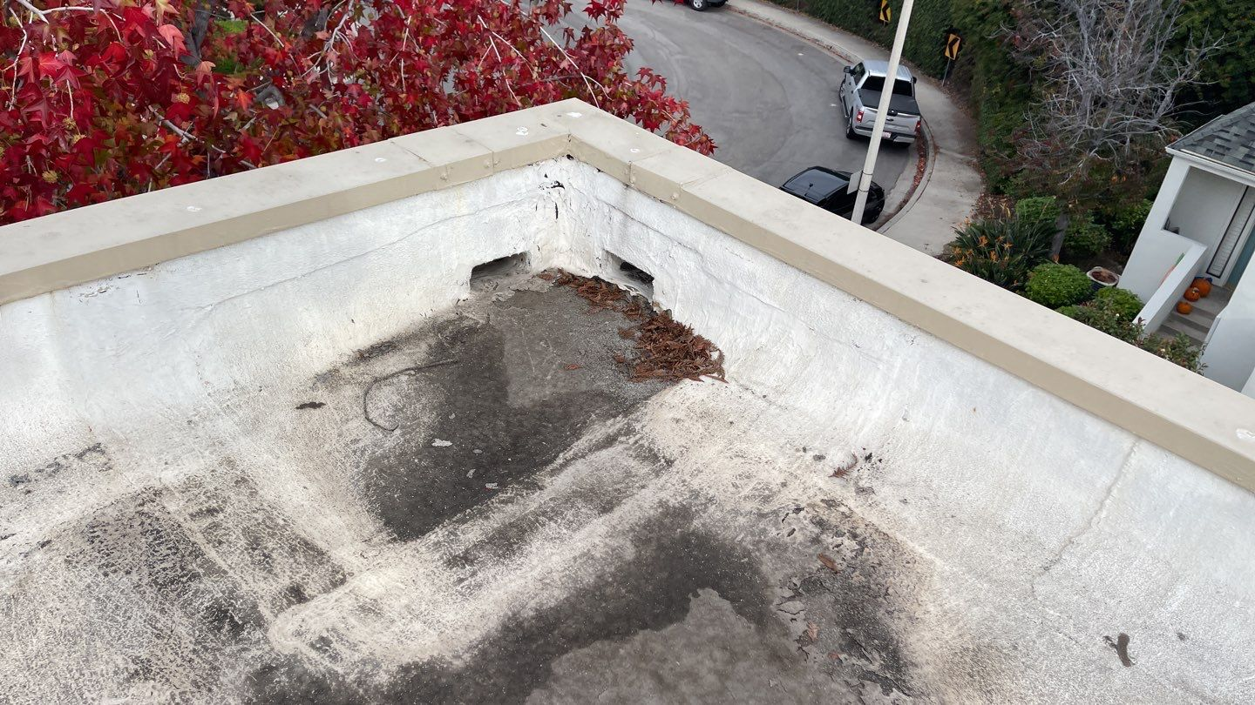
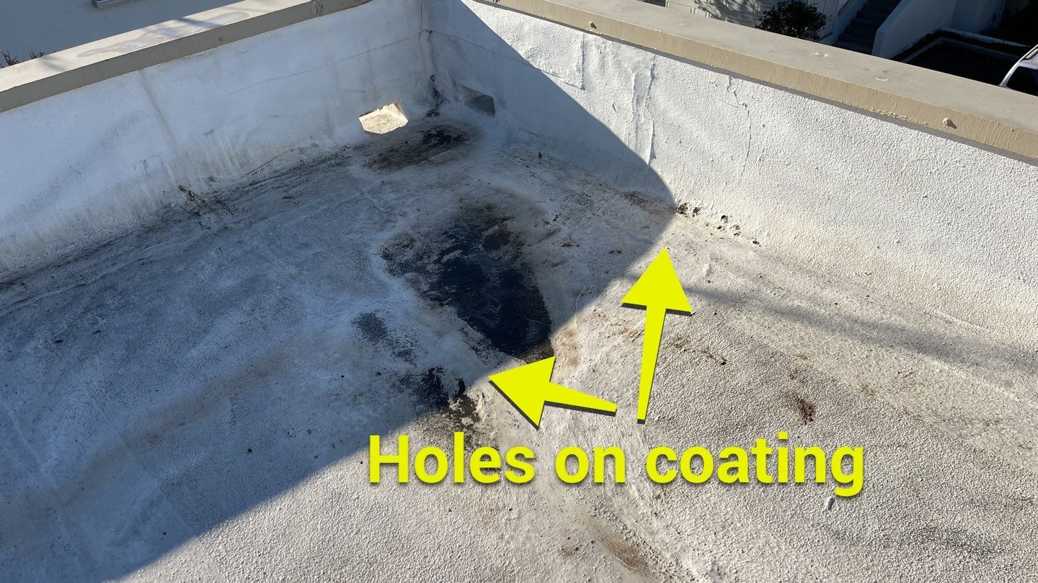
Roll-on coating continued

Slide 10
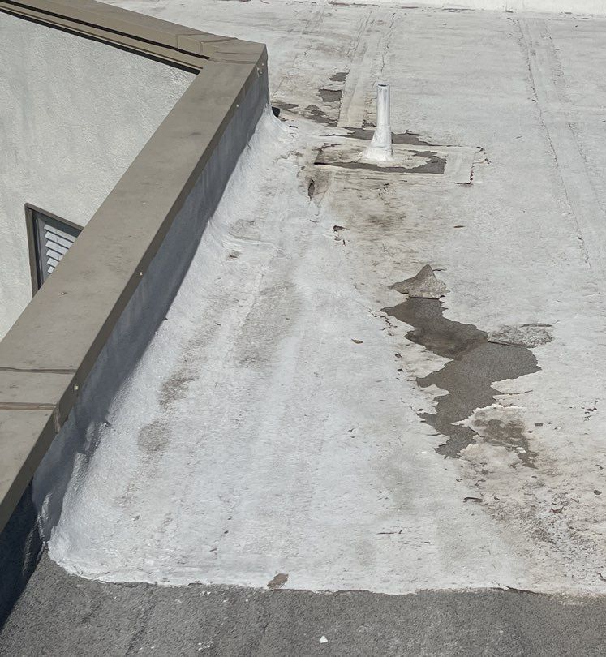
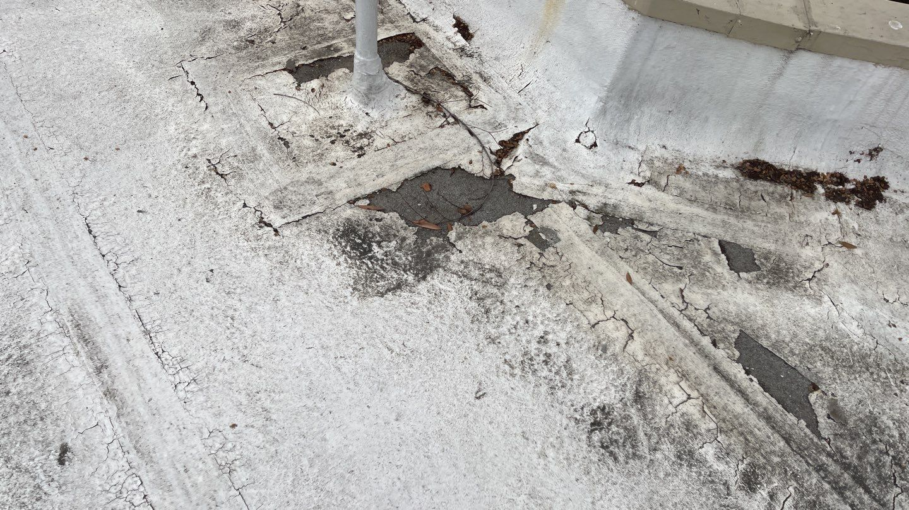
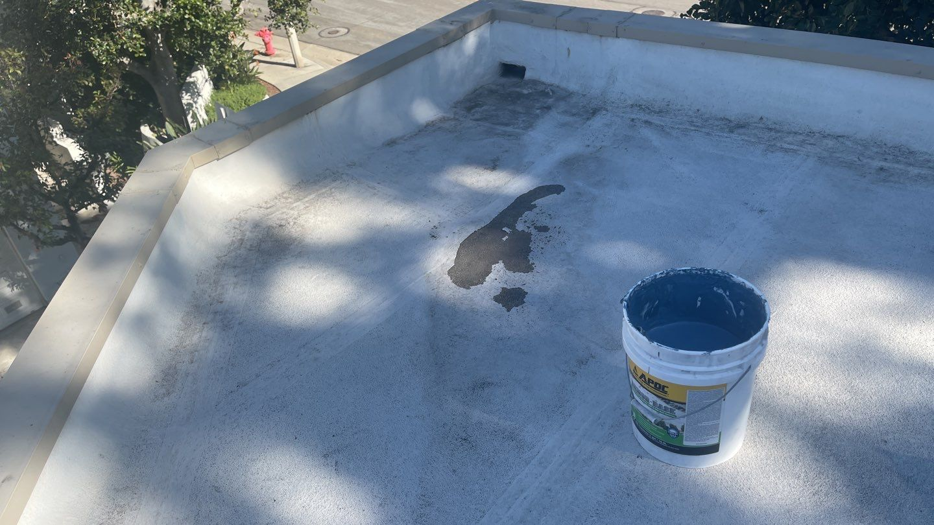
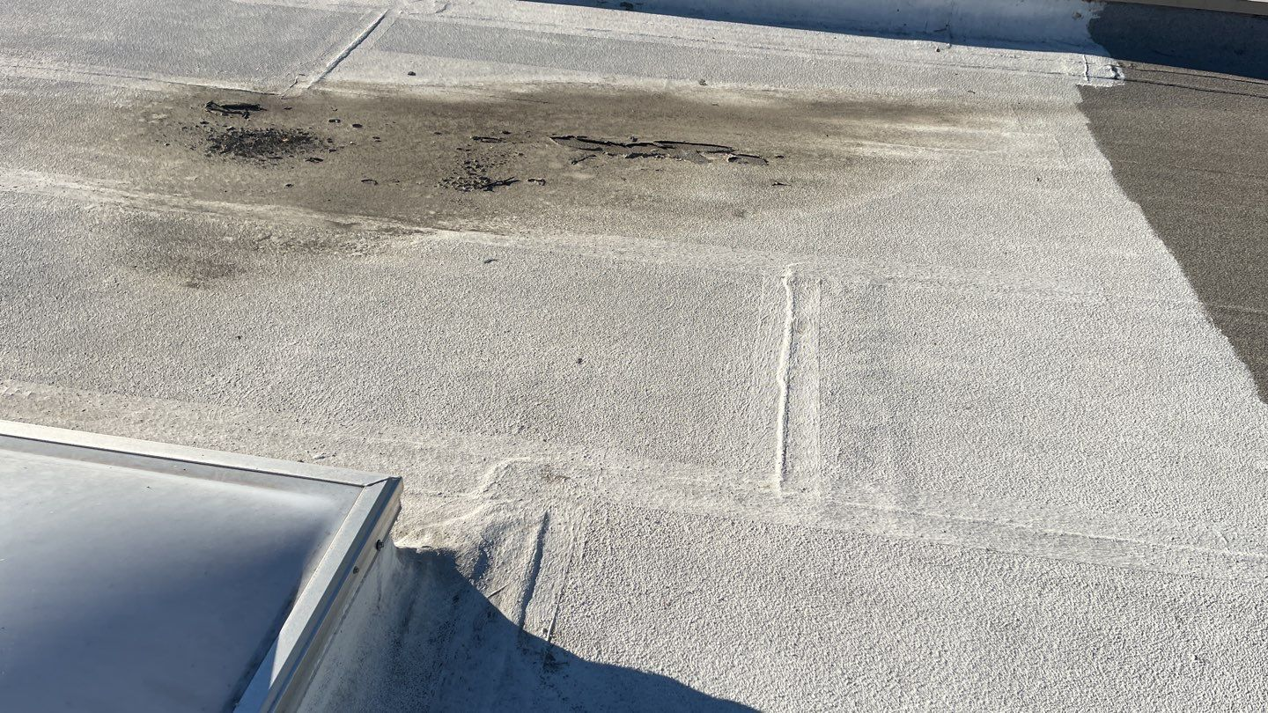
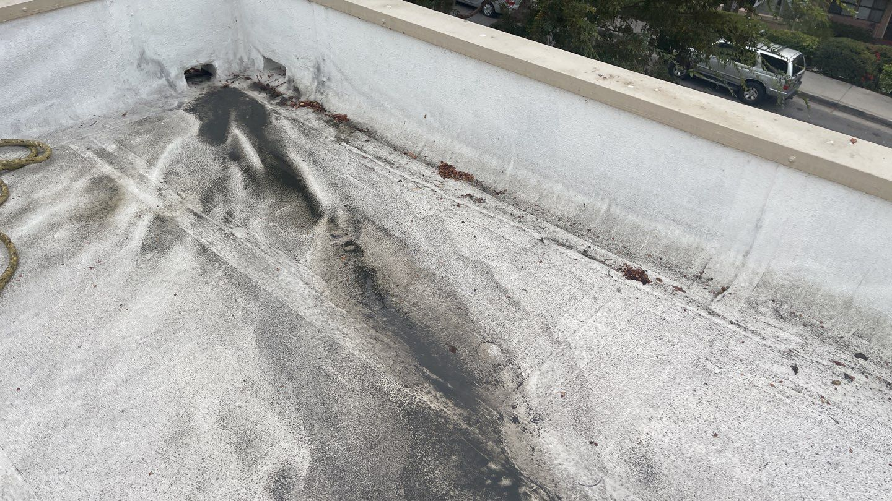
Roll-on coating continued

Slide 11
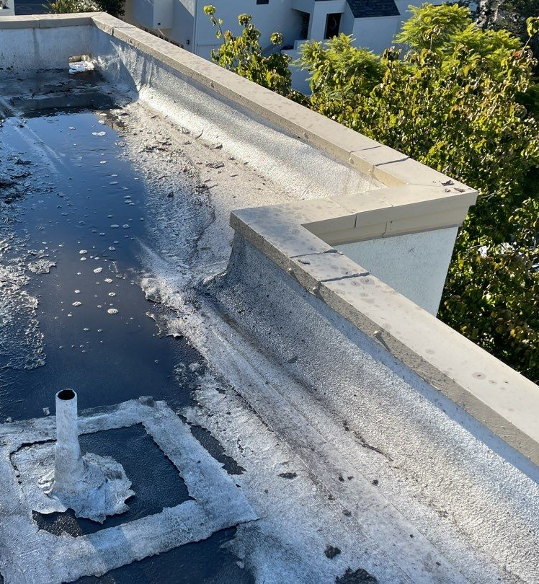
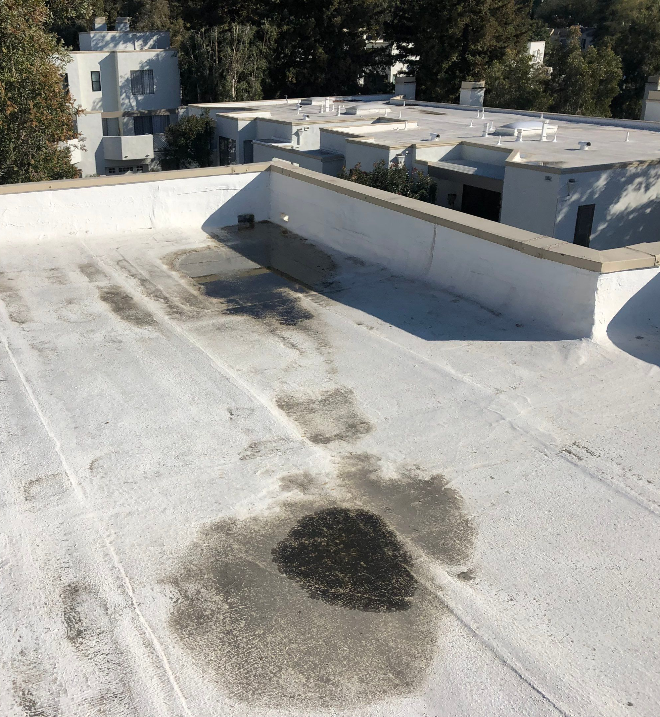
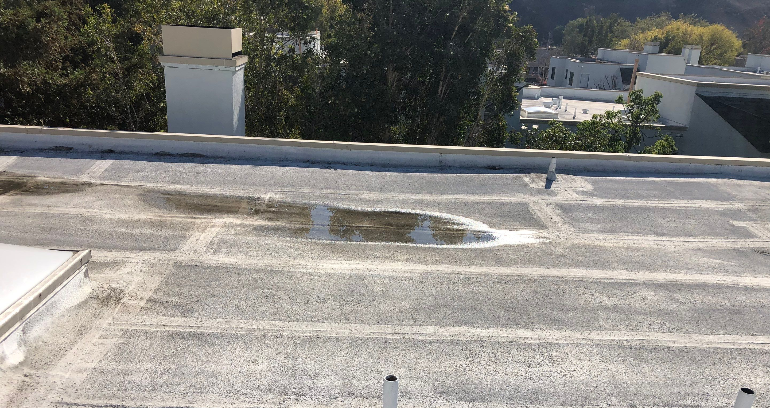
Ponding Water

Slide 12
Current Roof Condition
Indicators of roof failure
Coating delamination from ponding
Cracks telegraphing through the asphaltic roofs
Recent Maintenance (Antis Roofing and Waterproofing)
All visible failures were addresses
New failures are already showing up
Frequency of failures is increasing as the oils degrade
Ponding
Increases failures
Voids the built-up roofing (BUR) warranty

Slide 13
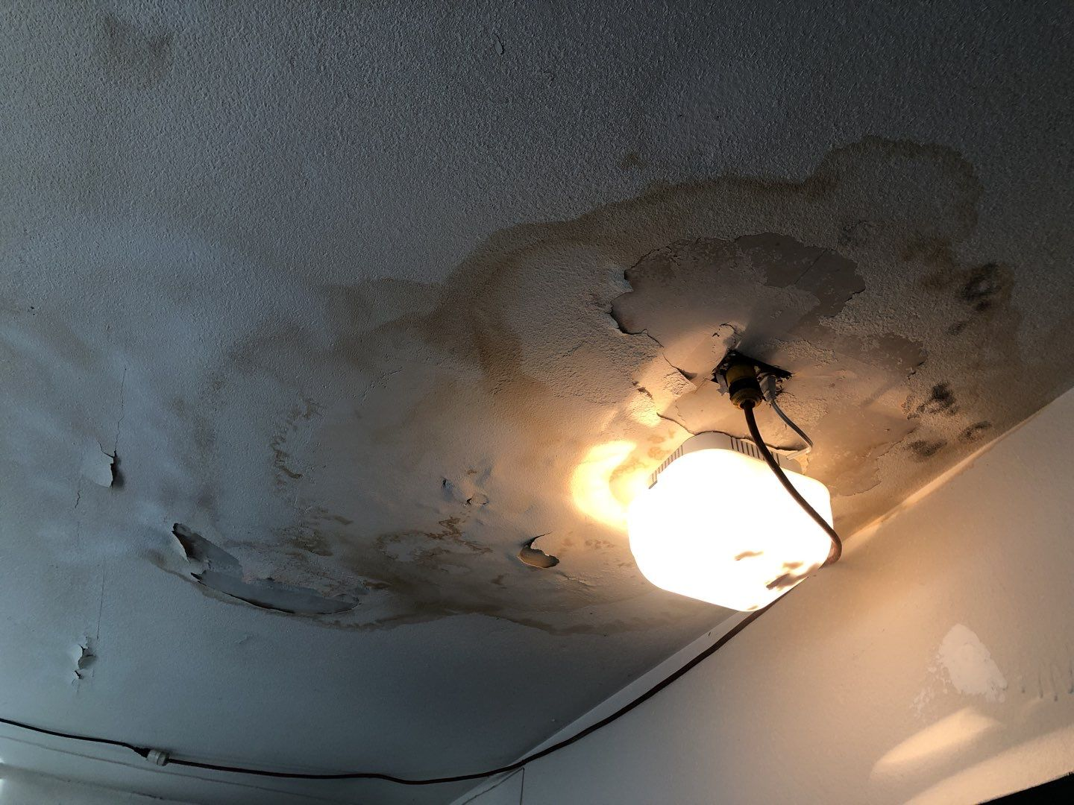
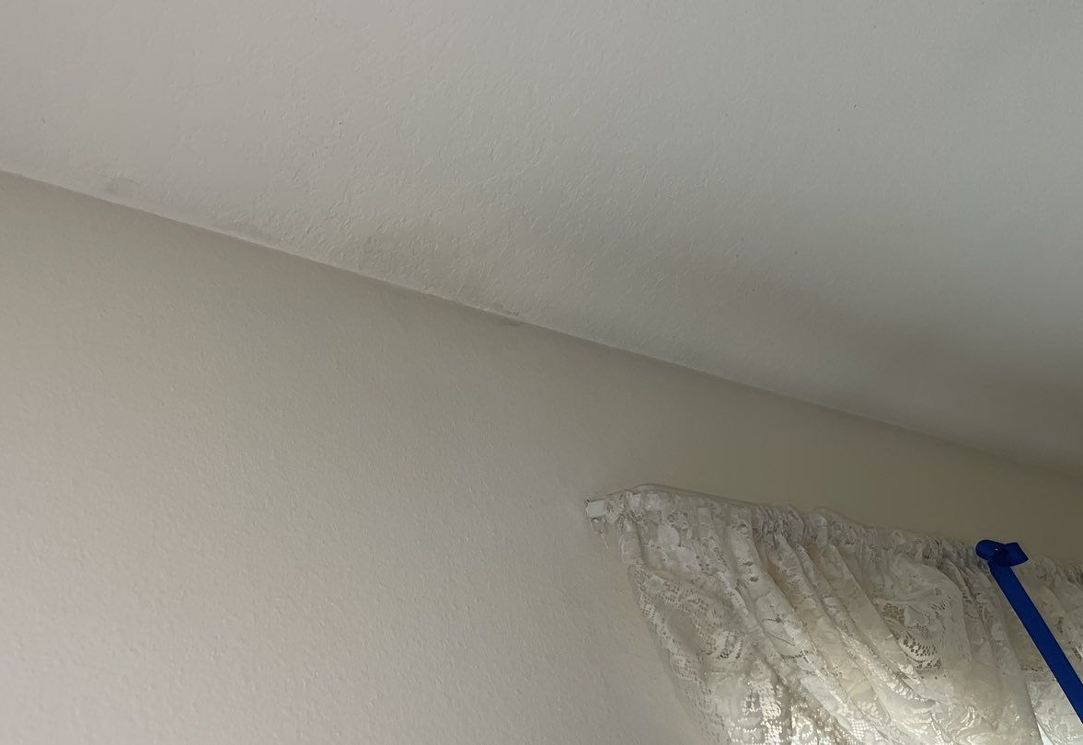
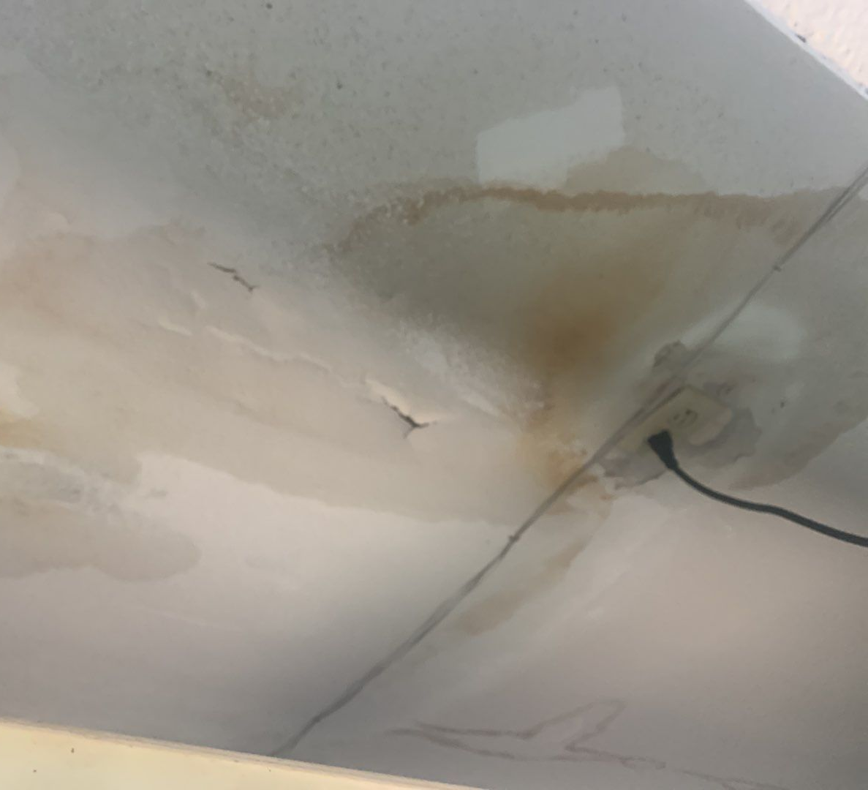
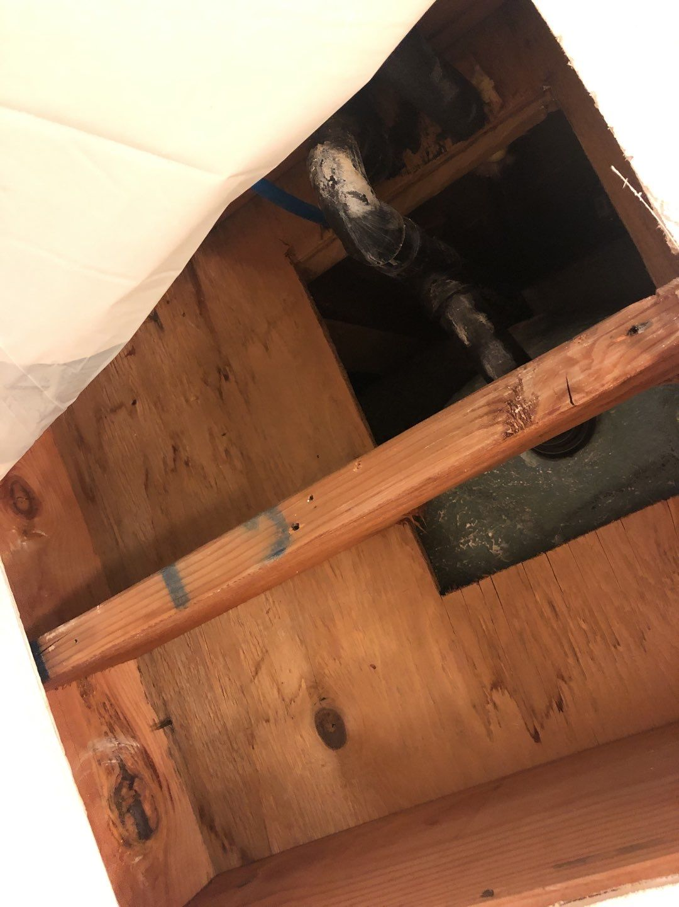
Interior leak damage at Stream House

Slide 14
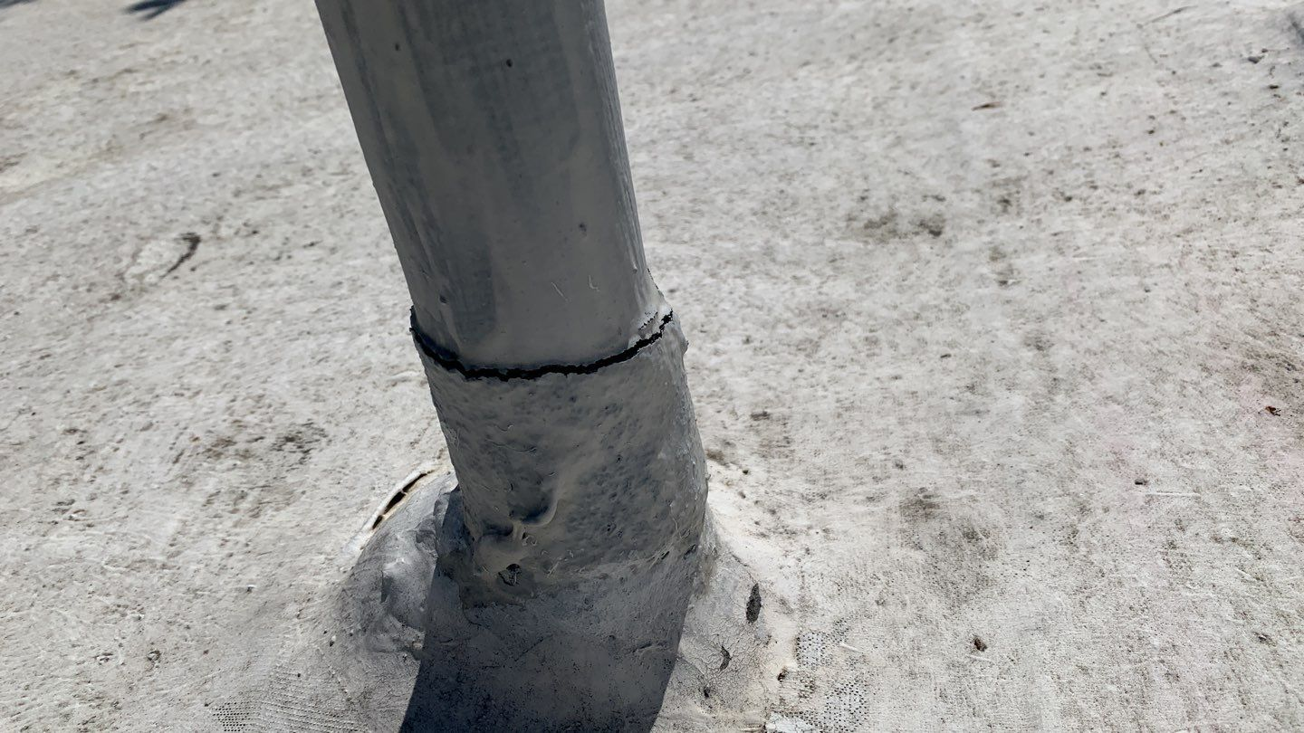
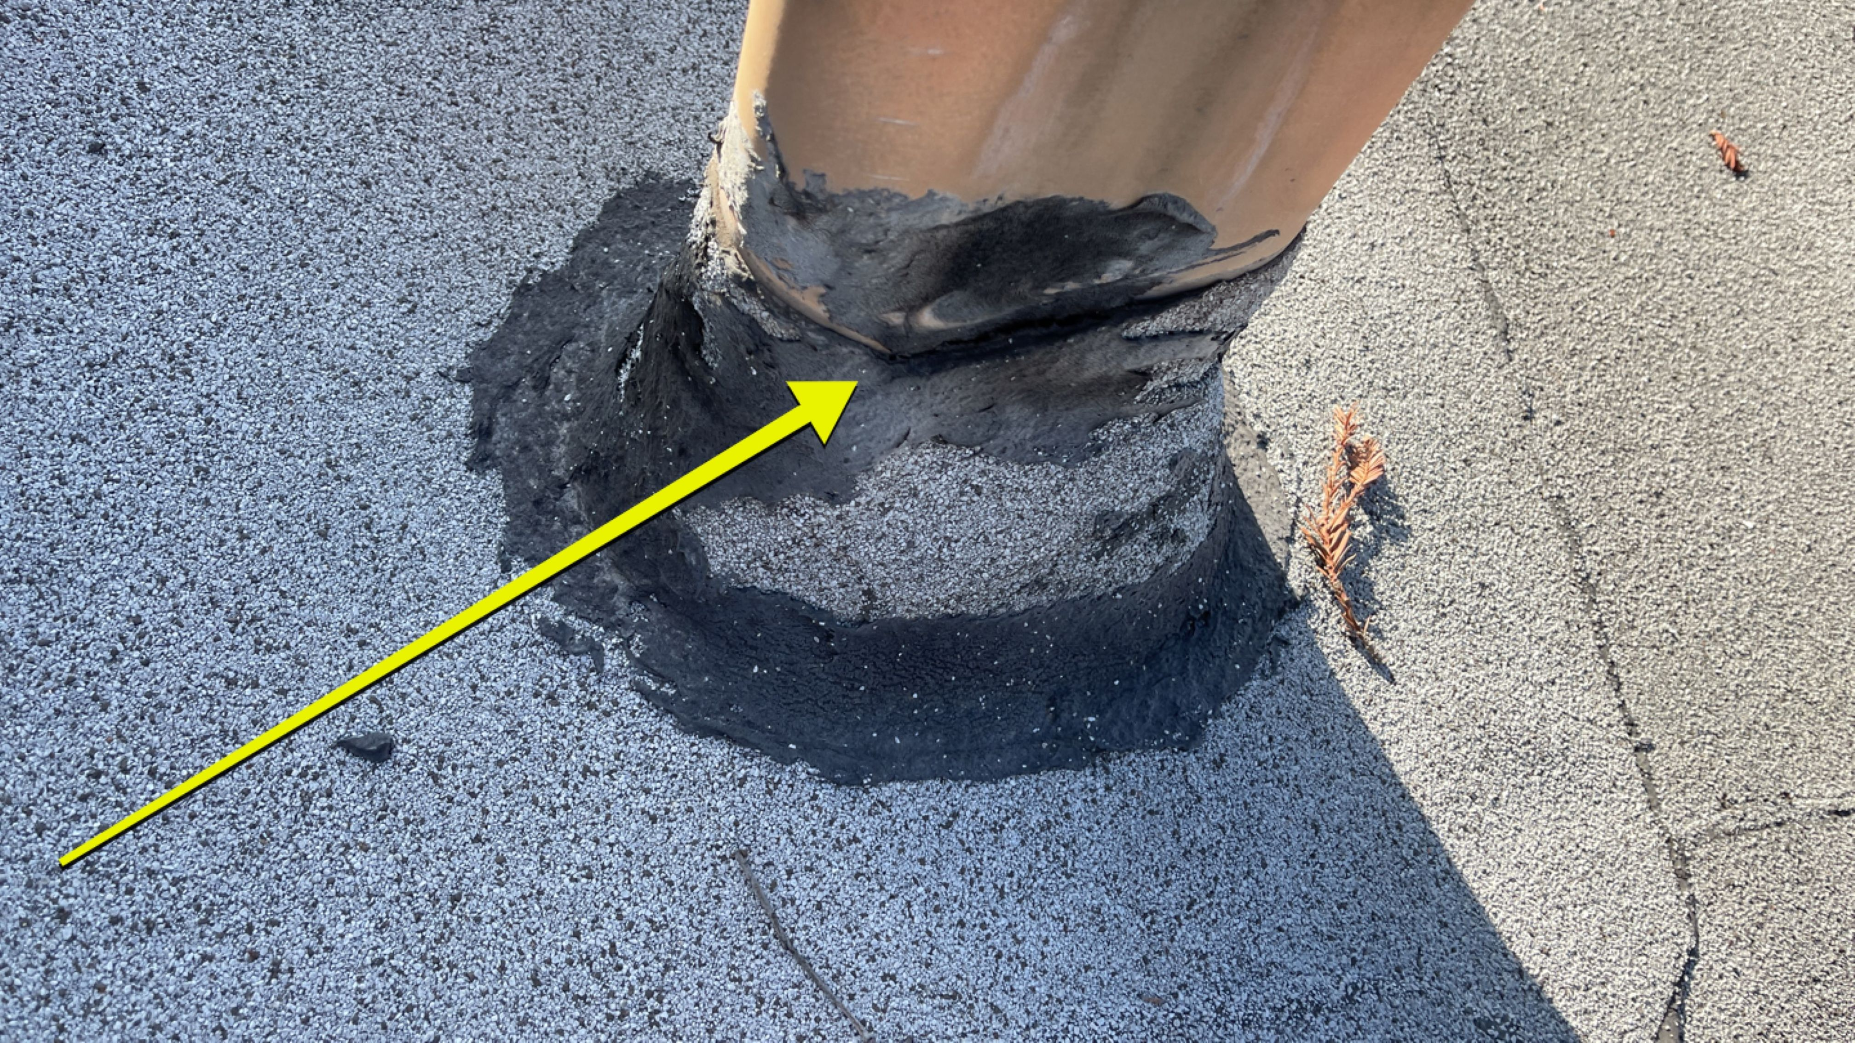
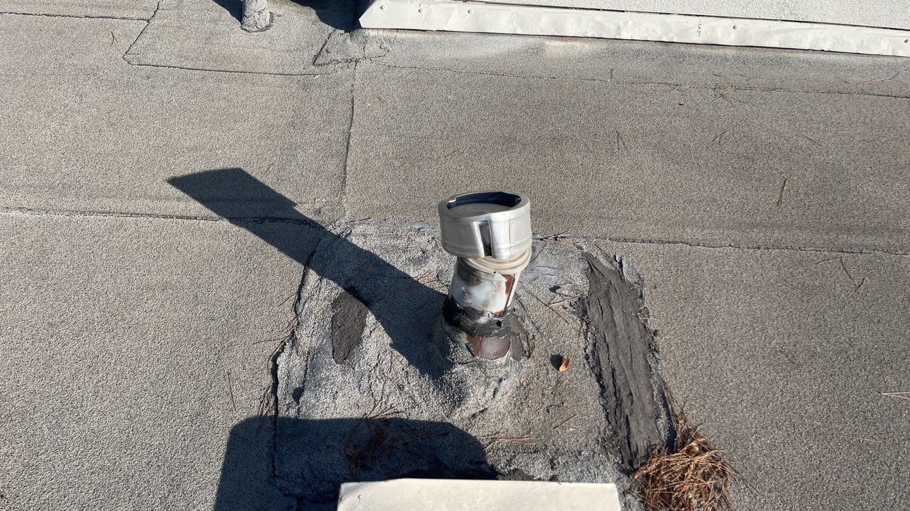
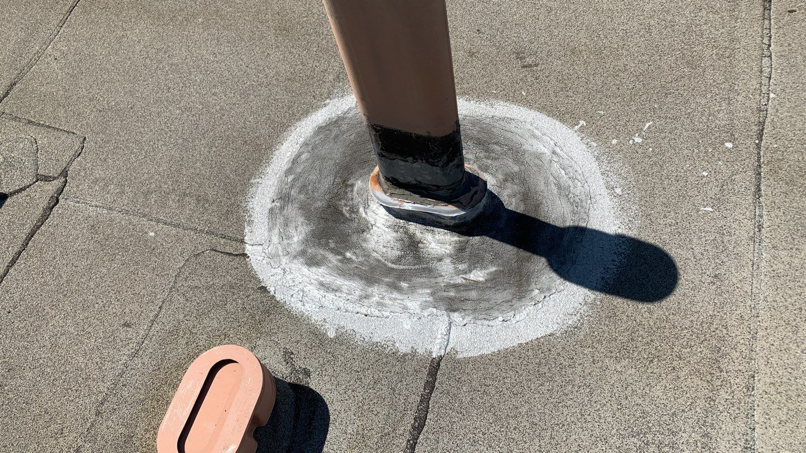
Previous Failure Areas - Pipes

Slide 15
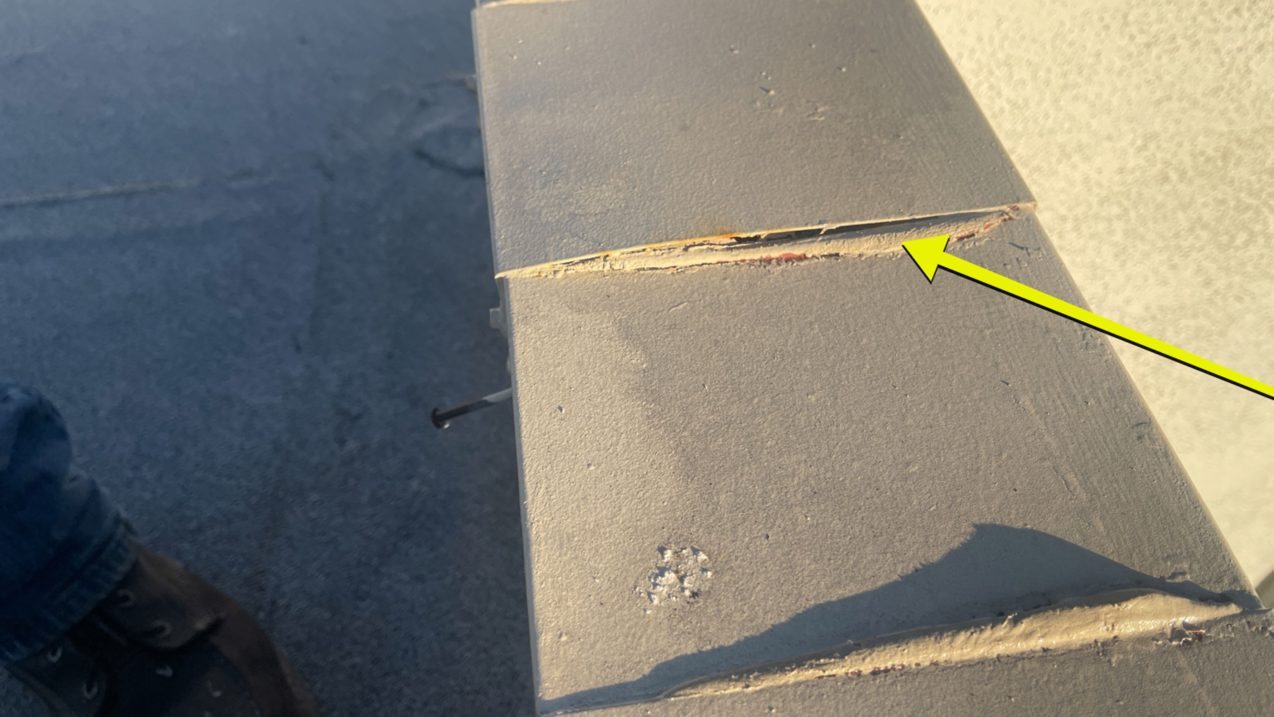

Slide 16
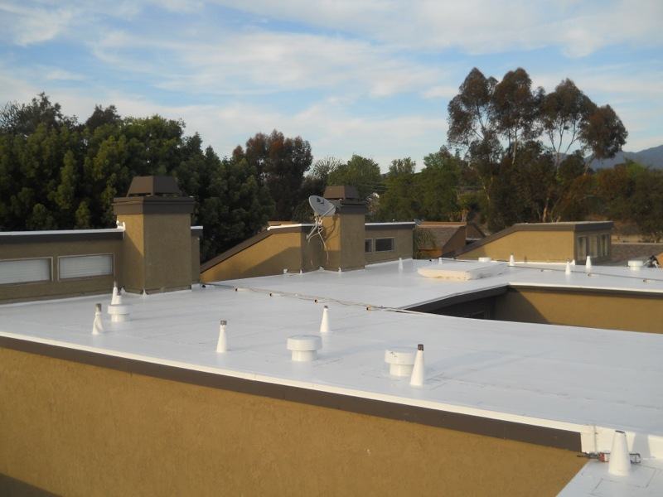
New single-ply PVC membrane addresses exiting roof’s weak points

Slide 17
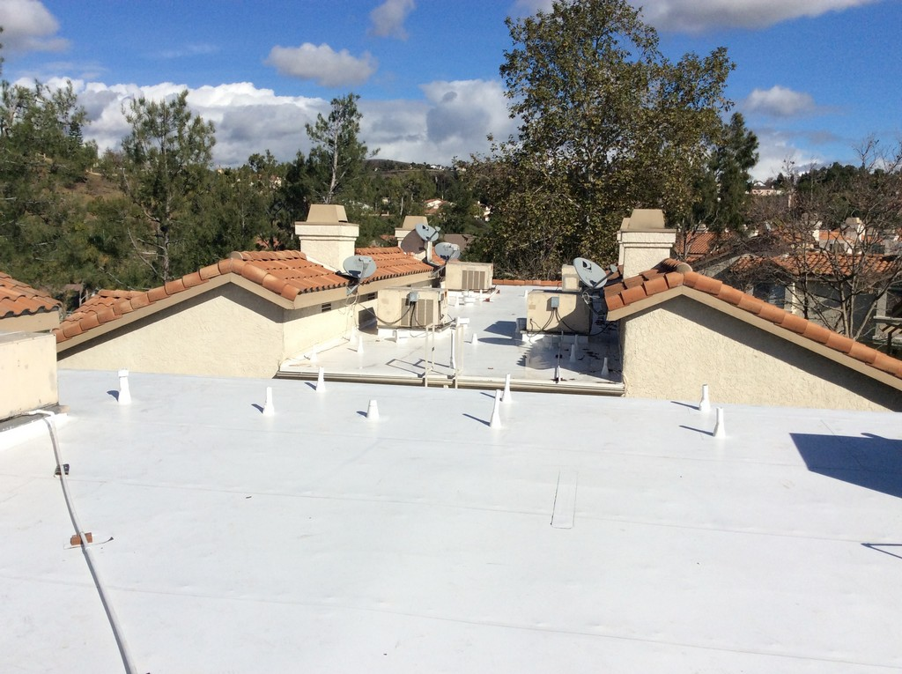
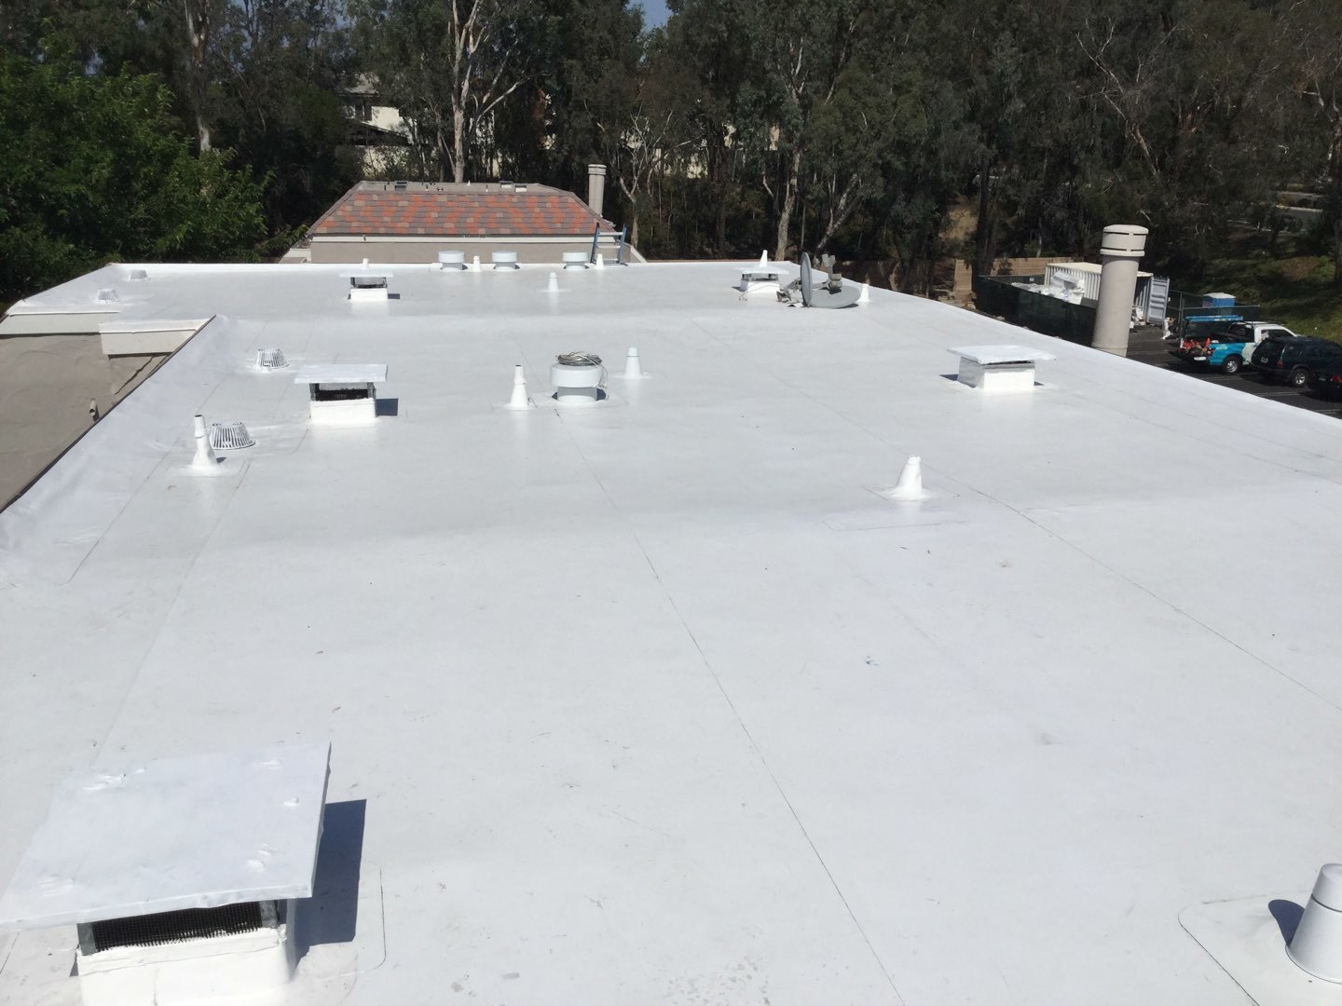
Flat Roof Materials & Warranty
IB Roof Systems – 60-mil PVC Roofing System
Extended 25-year Total Systems warranty
20-year no-dollar-limit warranty
Seams are welded with hot air, not an open flame.
PVC roofing is basically a modified pool liner, so any current ponding water is not an issue with this system and does not void the warranty.
Improved UV reflection

Slide 18
FLAT ROOF REPLACEMENT BUDGET
Item |  | Amount | Notes
Total Re-Roof Contract |  | $1,897,303.72
Roof Contingency | 10% | $189,730.37 | Estimated
Total |  | $2,087,034.09

Slide 19
02 DECKs
DECKS ARE FAILING

Slide 20
Current Condition of Decks
Ok to Poor
Decks rated “ok” need a maintenance coat
Decks rated poor have (or will soon) fail
222 total decks at Stream House (154 front and 68 rear)
67 are rated “ok”
121 are rated “poor”
14 decks have been repaired
10 decks are scheduled for repair
10 decks are approved and pending scheduling
Maintenance
Catches issues before they become major
Keeps “ok” decks from becoming “poor” decks
Should be top coated every 4 years

Slide 21
Holes In Deck Coating

Slide 22
Deck Failures

Slide 23
Coating Cracks Lead To Failure

Slide 24
Tile On Decks

Slide 25
DECK REPAIR PROJECT BUDGET
Item |  | Amount | Notes
Deck Repairs |  | $290,727.27
Deck Contingency | 30% | $87,218.18 | Estimated
Total |  | $377,945.45

Slide 26
03 stucco WATERPROOF coating
WEATHER-EXPOSED STUCCO WALLS (SOUTH & WEST)

Slide 27
STUCCO WATERPROOF COATING BUDGET
Item |  | Amount | Notes
Stucco Waterproofing |  | $291,000.00
Contingency | 5% | $14,550.00 | Estimated
Total |  | $305,550.00

Slide 28
Project Budget
ROOFS
01
DECKS
02
STUCCO WATERPROOF COATING
03

Slide 29
Stream House Revitalization Budget
Re-Roof | $1,897,304
Decks | $290,727
Stucco Waterproof Coating | $291,000
Subtotal (All Projects) | $2,479,031
Contingency & Project Mgmt., Misc. | $477,426
Project Total | $2,956,457

Slide 30
Funding The Plan – Loan
Loan amount: $2,960,000.00
Term:
12-month, non-revolving line of credit, then converts to a fixed rate loan
Collateral is a pledge of assessments not liens on your homes
Current interest rate: 8.25%
Fees: Commitment Fee of .25% = $7,400.00, documentation fee $500.00
Prepayment penalty: 5%, 4%, 3%, 2%, 1% on term portion) only in effect if the association re-finances with another lender)

Slide 31
Plan Payment Options
Pay upfront
No interest, principal only
$17,831.33 lump sum payment
Monthly payments
Estimated at $175 per month (includes principal and interest)
180 months
Can be transferred to new owner or settled at sale, it is entirely up to you!

Slide 32
Alternatives To A Loan
Reserves remain underfunded, delaying repairs for other items
Annual increases up to 20% year + 5% per year special assessment
More interior damage, resulting in redundant, costly repairs
Restricted use of home
Increased insurance premiums

Slide 33
Reduced Salability –Input From A New Owner
Underfunded reserve and disintegrated infrastructure cause:
Adverse impact to property values and our property investment
Higher HOA fees deter buyers interest in community
Reduced property values will result from higher HOA fees
High risk of “special assessments” drive property values down
Real estate “Black Listing”
Reserves of less than 15%: lenders won’t make less expensive loans “Fannie Mae” “Freddie Mac” because they can be resold in the market. Resulting in fewer buyers
Lack of reserves for unforeseen emergencies:
Local Orange HOA – Gas shut off at the street due to gas leak, HOA reserve fund concerns cause 4 week delayed leaving stakeholders without gas for cooking, hot water for showers more than 3 weeks.

Slide 34
“Pay and repair as you go” vs. Revitalization Plan
2022 plan - $402 monthly dues plus $177/month special assessment
2023 plan - $402 monthly dues (2022 dues) plus $80 monthly dues increase (2023) plus $175/month special assessment
Notes:
Red line can be the pay as you go line

Slide 35
Voting Requirements
To approve an assessment, more than half of all the units must return a ballot, and more than half of the votes that are cast must be in favor of the assessment.
Stream House has 166 units, so that means at least 84 units must return ballots to establish minimum quorum needed just to be able to open and count ballots. Provided quorum is met, to approve the measure a majority of the votes that are cast must be “yes”.

Slide 36
IT’S ALL UP TO YOU ~ EACH OF YOU!
We need your “Yes” vote!
We also need your neighbors’ “YES” votes as well for this to pass
Ballots will be mailed to your home on Monday, July 17, 2023
WE NEED YOUR HELP & SUPPORT TO SOLVE THIS AS A COMMUNITY!

Slide 37
Questions?
To raise your hand on Zoom
Click “reactions” at the bottom of your screen
Click “raise your hand”
To raise your hand on the phone
Press *9

Slide 38
In Person Meet & Greet
What – Pizza social to discuss project plan and voting
When – Wednesday, July 26th at 5:30 PM – 7:30 PM
Where - Villeurbänne Pool (260 N. Singingwood St Orange, CA 92869)
Why – Answer any questions relating to the loan vote

